Slide 1
HATE SPEECH RECOGNITION IN SOCIAL MEDIA
PREPARED by:
AARTHI LAKSHMI . R
CSE –THIRD YEAR
REG NO:613521104001

Slide 2

AGENDA
PROBLEM STATEMENT
OBJECTIVES
SYSTEM DEVELOPMENT APPROACH
ALGORITHM& DEPLOYMENT
RESULT
CONCLUSION
REFERENCES

Slide 3
PROBLEM STATEMENT
With the pervasive presence of social media platforms , here has been a concerning rise in the dissemination of hate speech , which includes abusive , discriminatory or offensive language targeting individuals or groups based on attributes such as race , ethnicity , religion , gender sexual orientation or disability . Detecting and mitigating hate speech online has become imperative to foster a safe and inclusive digital environment .
In this project , the goal is to develop an effective hate speech recognition and mitigation system tailored for social media platforms. The system should accurately identify and classify hate speech content in real time , enabling platform moderators to take appropriate actions such as content removal or user sanctions.

Slide 4
OBJECTIVES
Develop and train machine learning models capable of accurately detecting hate speech in textual content posted on social media platforms.
Curate and annotate a diverse dataset of hate speech samples to ensure model robustness across various languages , dialects and cultural contexts.
Investigate and Implement state-of-the-art natural language processing techniques for feature extraction and classification , considering nuances in hate speech language.
Evaluate the model’s performance using standard metrics such as precision, recall, and F1 score , while also considering the impact of false positives and false negatives on user experience.
Integrate the hate speech model into social media platforms’ content moderation pipelines , enabling real-time identification and flagging of potentially harmful content.
Develop mechanisms for continuous model monitoring and retraining to adapt to evolving patterns of hate speech and circumvention tactics employed by malicious actors.
Explore additional features such as user profiling and network analysis to enhance the system’s effectiveness in identifying coordinated hate speech campaigns.

Slide 5
SYSTEM DEVELOPMENT APPROACH
1.DATA COLLECTION:
Gather a diverse dataset of social media posts containing hate speech , along with non-hate speech posts for comparison.
2.DATA ANNOTATION:
Annotate the dataset to label instances of hate speech and non-hate speech. This step requires human annotators with expertise in identifying hate speech.
3.PREPROCESSING:
Clean and preprocess the data , including tokenization , removing noise(e.g., special characters ,URL’S), and possibly stemming or lemmatization.

Slide 6
4.FEATURE ENGINEERING:
Extract relevant features from the preprocessed text , such as word embeddings ,n-grams , or syntactic features
5.MODEL SELECTION :
Choose appropriate machine learning or deep learning models for hate speech recognition .Common choices include logistic regression , support vector machines , or deep neural networks such as LSTM or transfer models.
6.TRAINING:
Train the selected model on the annotated dataset .This involves optimizing model parameters to minimize a loss function , typically using techniques like gradient descent.

Slide 7
7.EVALUATION:
Evaluate the trained model on a separate test dataset to assess its performance . Metrices such as precision , recall , and F1 score are commonly used to measure classification performance .
8.FINE- TUNING:
Fine-tune the model based on the evaluation results to improve its performance. This may involve adjusting hyperparameters , using techniques like cross validation, or collecting more training data.
8.DEPLOYMENT:
Deploy the trained model to recognize hate speech in real-time social media streams. This may involve integrating the model into existing social media platforms or developing standalone applications .

Slide 8
ALGORITHM & DEPLOYMENT
One common algorithm used for hate speech recognition in social media) is the LONG SHORT-TERM MEMORY (LSTM ) network , which is a type of recurrent neural network (RNN).LSTM networks are particularly effective for sequence modeling tasks like text classification because they can capture long-range dependencies in the input data.
LSTM works are typically applied to hate speech recognition by
Data Preprocessing
Embedding Layer
LSTM Layers
Output Layer
Training
Evaluation
Fine –Tuning
Deployment

Slide 9
CODE IMPLEMENTATION
import pandas as pd
import numpy as np
from sklearn.feature_extraction.text import CountVectorizer
from sklearn.model_selection import train_test_split
from sklearn.tree import DecisionTreeClassifier
import nltk
nltk.download('stopwords')
import re
from nltk.corpus import stopwords
stopword=set(stopwords.words('english'))
stemmer = nltk.SnowballStemmer("english")
data=pd.read_csv("/content/drive/MyDrive/DataSet/labeled_data.csv") print(data.head())

Slide 10
data["labels"]=data["class"].map({0:"Hate Speech", 1:"Offensive Speech", 2:"NoHate and Offensive Speech"})
data=data[["tweet","labels"]]
data.head()
import re
def clean (text): text = str(text).lower()
text = re.sub('[.?]', '', text)
text = re.sub('https?://\S+|www.\S+', '', text)
text = re.sub('+', '', text) text = re.sub(r'[^\w\s]','',text)
text = re.sub('\n', '', text) text = re.sub('\w\d\w', '', text)
text = [word for word in text.split(' ') if word not in stopword]
text=" ".join(text)
text = [stemmer. stem(word) for word in text. split(' ')]
text=" ".join(text)
return text
data["tweet"] = data["tweet"].apply(clean)

Slide 11
x=np.array(data["tweet"])
y=np.array(data["labels"])
cv=CountVectorizer()
X = cv.fit_transform(x)
X_train,X_text,y_train,y_testtrain_test_split(X,y,test_size=0.33,random_state=42)
model= DecisionTreeClassifier()
model.fit(X_train,y_train)
y_pred=model.predict(X_text)
from sklearn.metrics import accuracy_score print(accuracy_score(y_test,y_pred))
i="You are too bad and I dont like your attitude“
i = cv.transform([i]).toarray()
print(model.predict((i)))

Slide 12
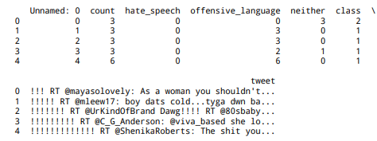
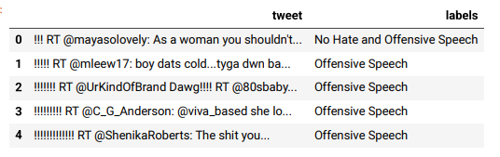
RESULT
[nltk_data] Downloading package stopwords to /root/nltk_data... [nltk_data] Unzipping corpora/stopwords.zip.

Slide 13

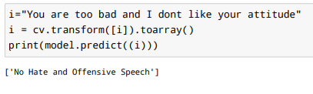
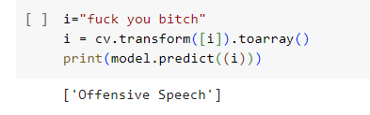

Slide 14
CONCLUSION
The model we have trained is a little over fitting the training data but we can handle this by using different regularization techniques. But still, we had achieved 90% accuracy on the validation data which is quite sufficient to prove the power of LSTM models in NLP-related tasks.

Slide 15
REFERENCES
Here are a few academic papers and resources that focus on hate speech recognition in social media:
1.Davidson,T.,Warmsley, D., Macy , M., & Weber , I.(2017).Automated hate speech detection and the problem of offensive language . In Proceedings of the 11th International AAAI Conference on Web and Social Media. This paper discusses the challenges and approaches to automate hate speech detection
, particularly in the context of offensive language.
2.Zhang,B.,Luo,L.,&Wang,B.(2018).Detecting hate speech on social media:A critical review.In 2018 IEEE International conference on Information Reuse and Integration (IRI) (pp.108-115).This paper provides a critical review of hate speech detection methods on social media platforms.

